Slide 1
Report Q4 2020
Adoption
Support and training
Process
Development
Capacity for Q4

Slide 2
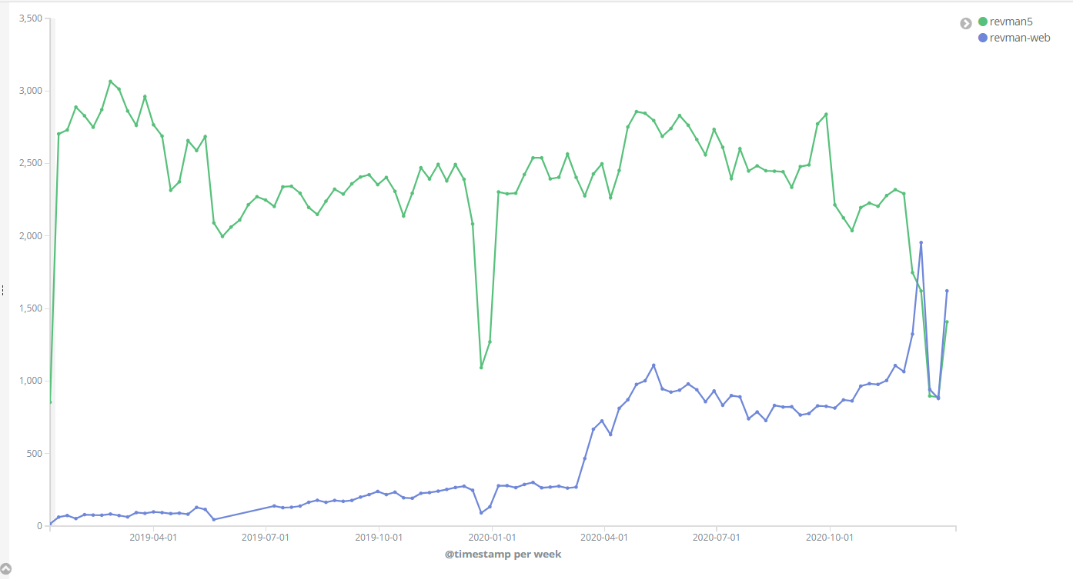
Adoption
Activity in RevMan Web passes activity in RevMan 5

Slide 3
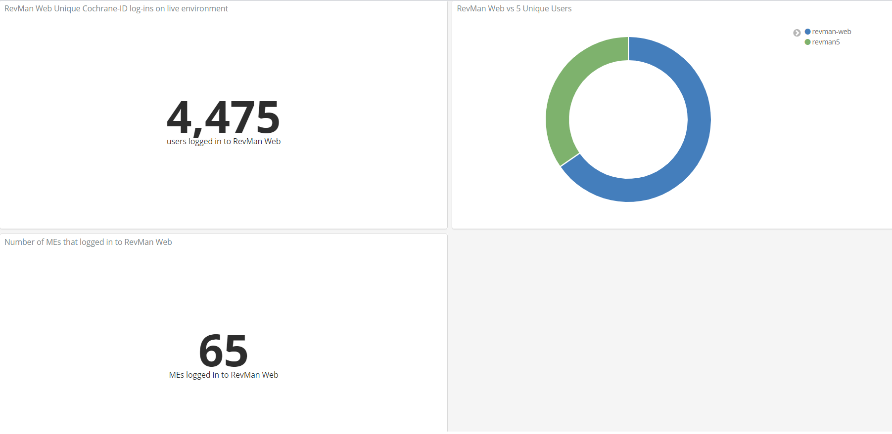
Editorial teams now active in RevMan Web
(+1471)
Q4 2020
(+26)

Slide 4
Use of new features in RMW
More reviews are only editable in RevMan Web:
GRADEpro integration: 37 (+17) reviews
RoB 2: 23 (+ 10) reviews
Study-centric data: 3 (+ 0) reviews
These features break RevMan 5 compatibility (you cannot check out)

Slide 5
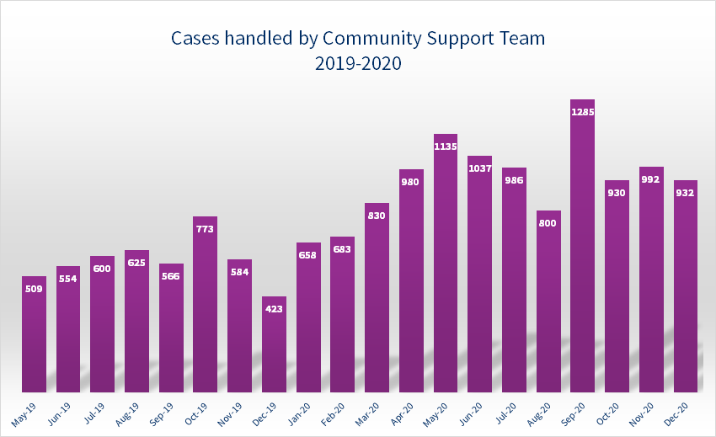
Support
Data for Q4
RMW 459 tickets
RM5 233 tickets
Out of tickets
Data for Q3
RMW 435 tickets
RM5 114 tickets
Out of 2842 tickets
Data for Q2
RMW 782 tickets
RM5 ? tickets
Out of 3152 tickets
Data for Q1
RMW 469 tickets
RM5 201 tickets
Out of 2208 tickets

Slide 6
Support tickets broken down
81 (-44) synced reviews (all synched on Dec 9th)
29 (-23) requests where review was already synced
71 (-36) requests by non-cochrane authors
7 (-5) request from authors of other non-supported review formats
90 (+41) problem reporting forms
54 (+14) suggestions

Slide 7
Process changes
  Decision on priorities moved from quarterly roadmap session to PO
  Quarterly roadmap updates and voting sessions replaced by recurring catch-ups with all stakeholders (sharing priorities between stakeholders is still important)
  Time horizon for roadmap changed: Now= this quarter, Next= next quarter, Future = after next quarter
Notes:
Apart from the improvements in the previous slide, there are three important new features that review groups can trial.

Slide 8
Development
Remove synchronization process & versioning related features released - Done
Increase reliability - Done
Global edits - Done
Full-text view – Done
Submit to new EMS – In progress

Slide 9
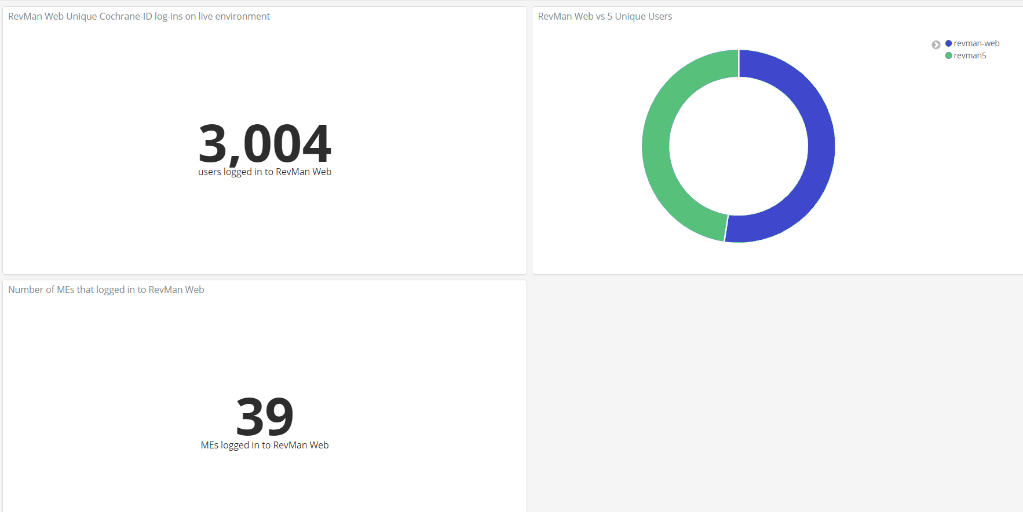
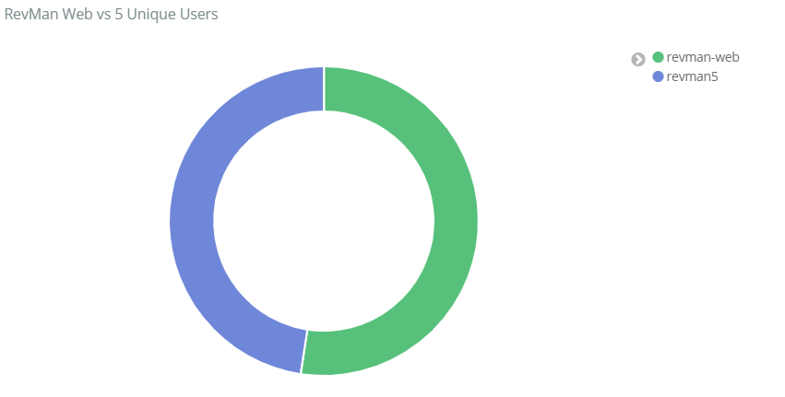
Q3 2020

Slide 10
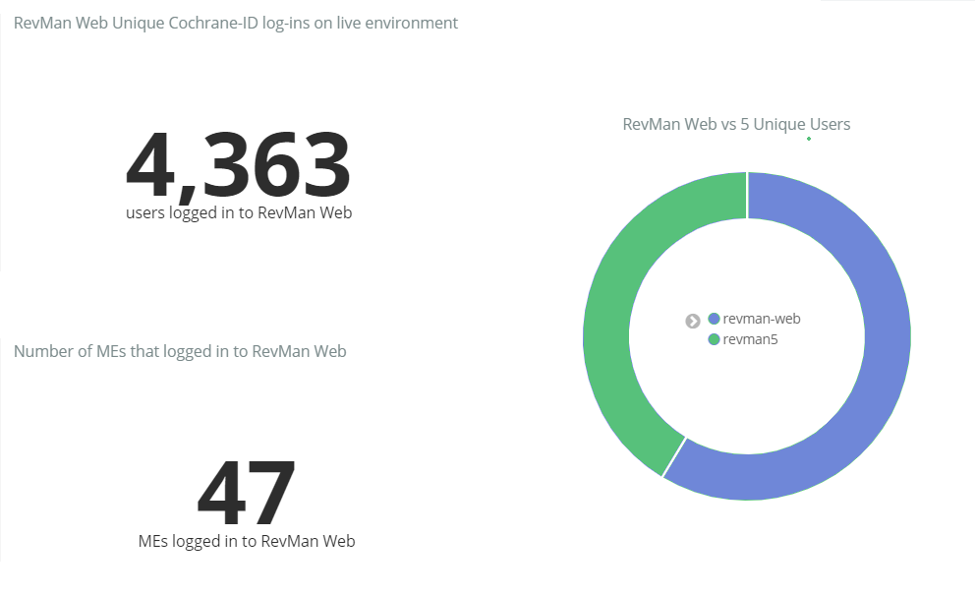
Q2 2020
(Q2 was 2 weeks longer due to summer holidays)
Q2 2020

Slide 11
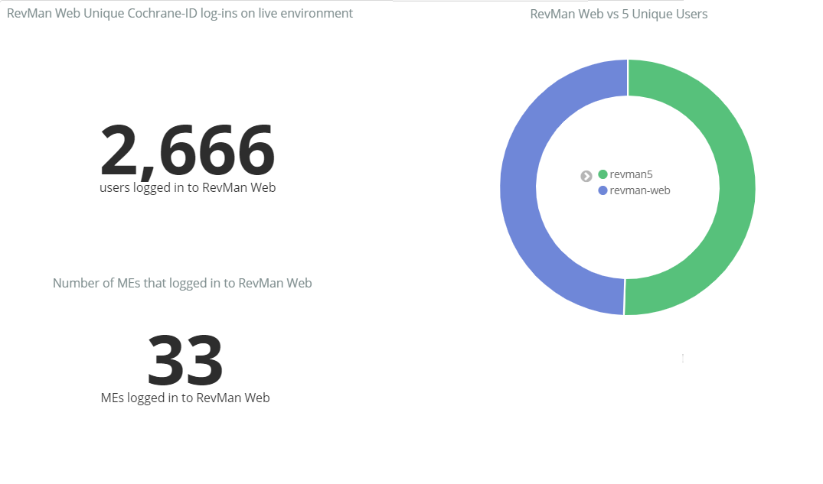
Q1 2020

